Slide 1
Lecture 6: Introduction to Classes and Objects
陳仲儼 教授
國立中央大學資訊管理學系
EMAIL: cychen@mgt.ncu.edu.tw
Reference book: Ch7

Slide 2
L6-1 Classes, Objects, Methods & Instance Variables
First of all: Concept of classes(類別) & objects(物件):
Take cellphone as example:
Before a cellphone can be used, it must be made
Before a cellphone is made, its functionality (e.g. make calls, text messages,…) must be designed first.
With Java’s class & object concept:
The design & specs of cellphones ➔
The functions of cellphone ➔
Cellphones produced based on the design➔
Syntax to create a cellphone object ➔
Call a cellphone object to perform its functions (e.g. Use a cellphone to make a call ➔

Slide 3
Car Example in Java
public class CellPhone{
public void makeCall(String number){ ….}
public void textMsg(String msg){…}
….. //other functions
}
Design of the functional specs for class CellPhone
public class TestDrive{
public static void main(String [] args){
CellPhone cp = new CellPhone();
cp.makeCall(“034227151”);
}
}
A CellPhone object is created
Call the created object to perform its functions (to make a call)

Slide 4
Besides methods, a class may have attributes (variables)
So far, methods and variables are the two types of members of a class
For variables/attributes:
Attributes are also a part of class design in order for every object of the class to carry its own data. ➔ called ________________
FYI: “Static variables” will be introduced later
For example, instance variables of Car class can be??

Slide 5
Back to the Car Example
public class Car{
public String owner;
public String eng_number;
public int mileage;
public void driving(){ ….}
}
instance variables
instance method (因為無宣告static)
public class TestDrive{
public static void main(String [] args){
Car c = new Car();
c.owner=“Johnny”;
c.eng_number=“ABDFY667H”;
c.mileage=1000;
}
}
If no explicit initialization of variables, a default value is given

Slide 6
L6-2 Accessibility of Class Members
Defining the accessibility of a class’s members (__________ & ___________________) is to determine the call boundary for the members of the class.
➔________: can be called from outside the class
➔________: can only be available to its class members
Methods should be _________if they are defined to be called/accessed from other classes/objects
Instance variables should be _________
What if instance variables are public ??? @

Slide 7

Accessing object’s private data
Example:
➔ So for security, instance variables should be declared private to prevent information leak (being freely accessed externally).
Meanwhile, define _________________ in class design for allowing to appropriately access private instance variables/data
The ___________ methods
So there are two types of methods in a class:
Functional & service methods@
public class Girl{
public int age;
public int weight;
public String LineID;
….
}
public class Party{
public static void main(…){
Girl mary = new Girl();
…..
String LineID = mary.LineID;
}

Slide 8
Class’s Security Design
public class Girl{
private String LineID;
….
public String getLineID(){
if (I like you?){ return “….”; //LineID content
else{ return “謝謝再聯絡”; }
}
public void setLineID(){ …. }
….
} //in Pseudo code
public class Party{
public static void main(String [] args){
Girl mary = new Girl();
String result = mary.getLineID();
}
}

Slide 9
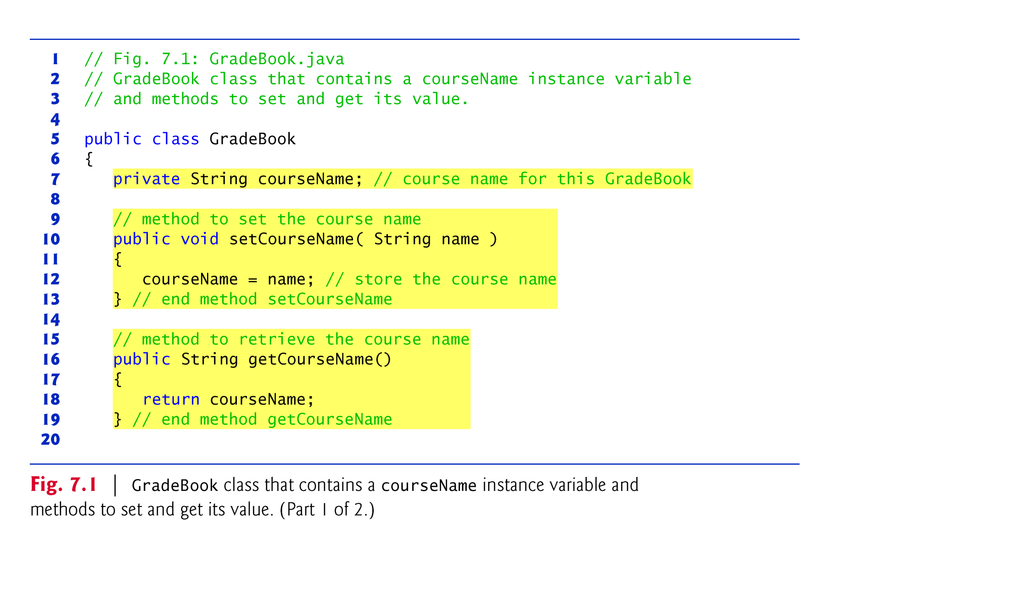
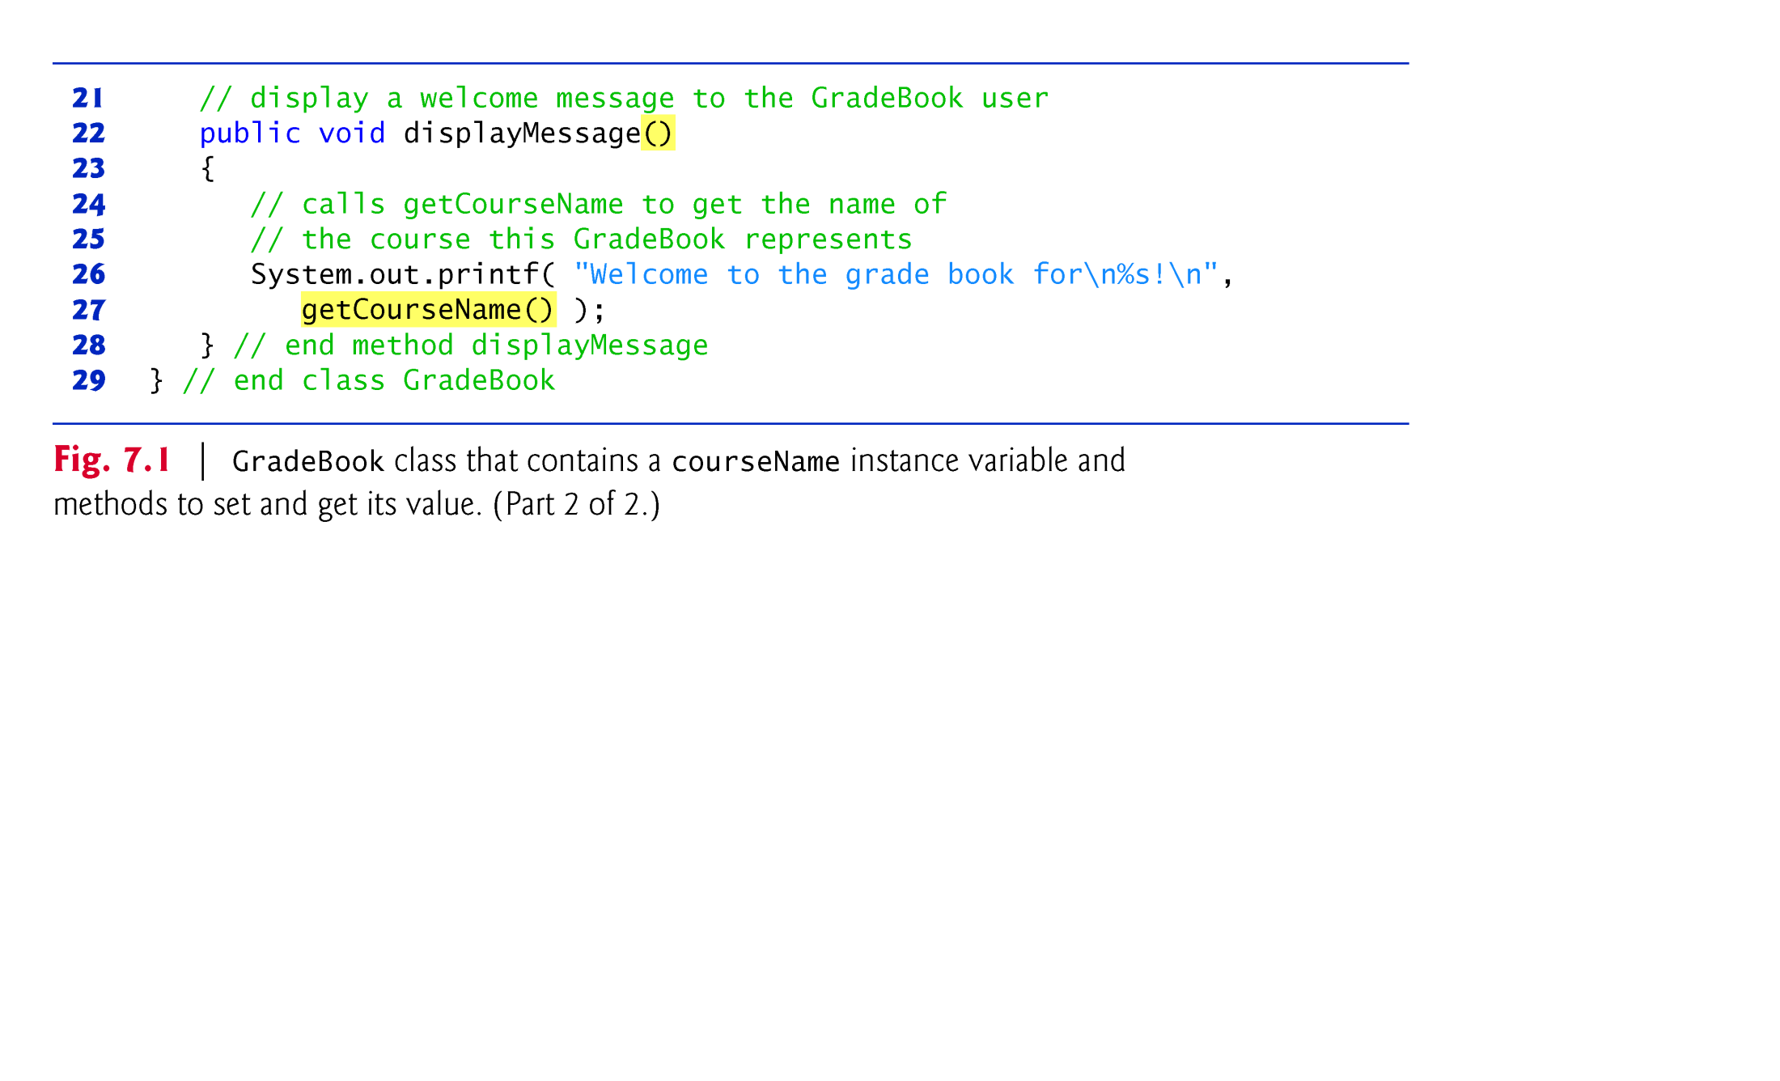
Example:
Service methods(服務方法) 提供外界讀取不公開變數的值的管道。未來你可進一步放入某些身分驗證程式在這些服務方法中

Slide 10
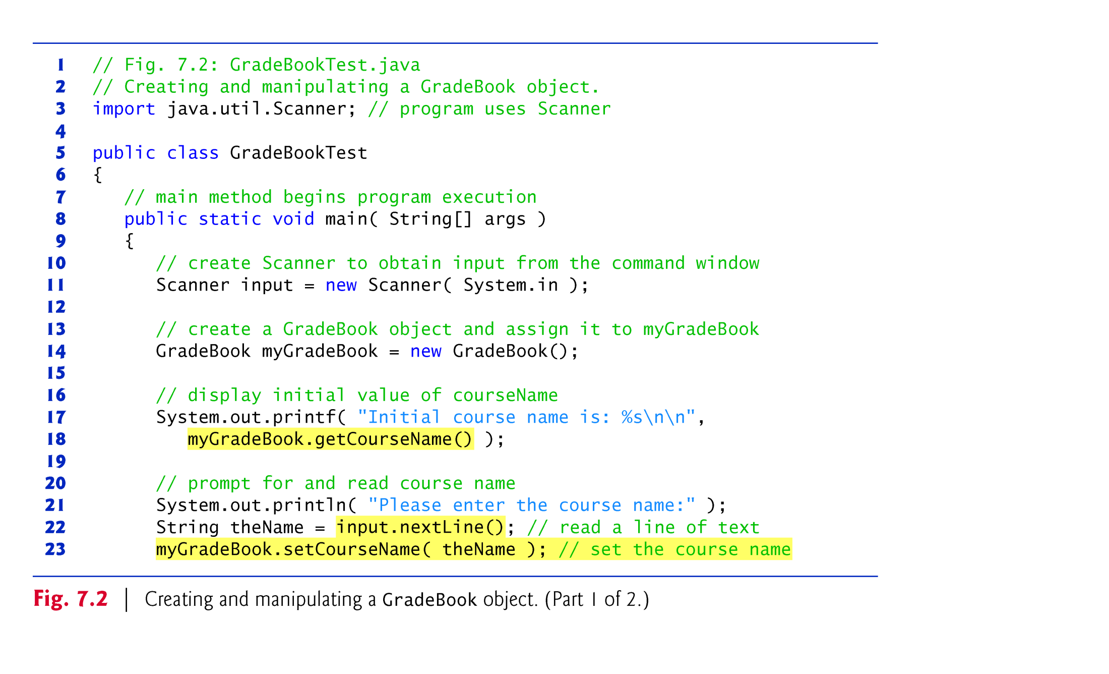
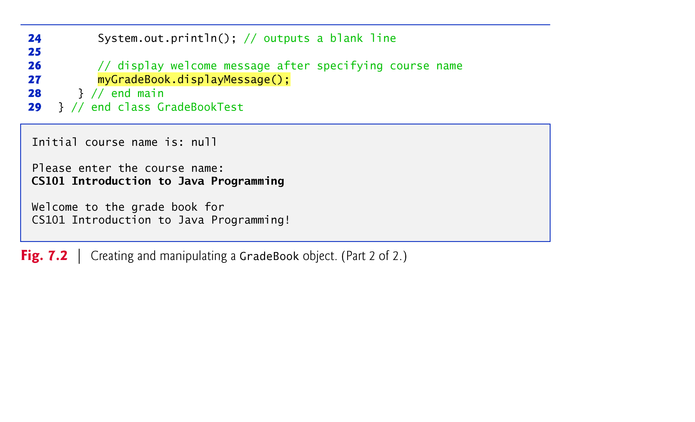
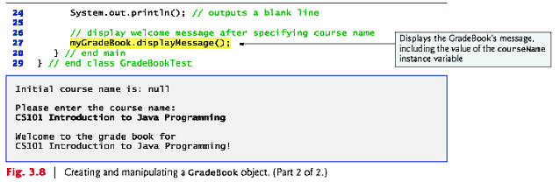
GradeBookTest:
Object creation
Read a sentence input

Slide 11
整理：
Creating an object is called _______________________
Data encapsulation is to declare variables as _________
Java classes must provide ________________________ for the private variables/data
In terms of design, two types of methods in a class: (1)________________ (2)________________
GradeBook稱為___________________； 而應用/使用GradeBook的GradeBookTest稱為 _________ class (使用者程式/應用類別)
User classes需要有______________ (為什麼？) Entity classes則不需要
The interactive java files are placed in the same folder@

Slide 12
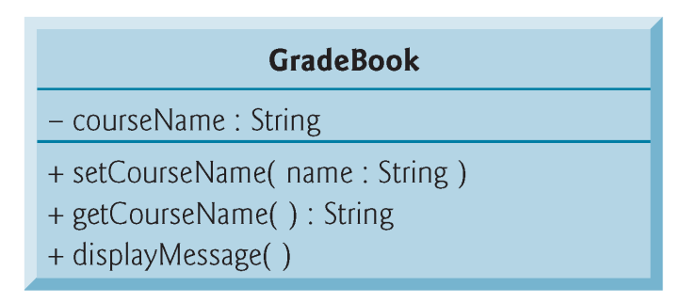
System analysis & design
To model/design the specs of Java classes in early phase before programming ➔ use UML class diagram(類別圖)
In UML class diagrams, each class is modeled as a rectangle with three compartments. Take GradeBook as example:
The top compartment contains the class name in boldface type
The middle compartment contains the class’s attributes (instance variables)
The bottom compartment contains the class’s functions (methods)@
注意符號的使用

Slide 13
EXE 6_1
(Banking IS) Design the class Account
Brainstorm the attributes(instance variables) that Account should have➔
Instance variables:
Should the variables be private?
Brainstorm the methods that Account class should have:
Service methods
Functional methods:
Draw the class diagram for Account
例如:

Slide 14
Class diagram of Account:
Account
-name: String
-acctNo: String
-balance: double
+setName(name: String)
+getName(): String
+setAcctNo(AcctNo: String)
+getAcctNo(): String
+setBalance(balance: double)
+getBalance(): double
+deposit(money: double)
+withdraw(money: double)
或: +setName(String name)

Slide 15
L6-3 Constructors & Initializing objects using constructors
<<本主題通常不易理解，宜注意聽講>>
An entity class often has a method-like member called constructors (建構程式\建構子) so when an object of class is created:
___________
___________
So during instantiation, Java requires a constructor call for every object that is created
Constructors are the third member of a class @

Slide 16
L6-4 Defining constructors
Syntax of defining a constructor for an entity class:
public ClassName(parameters){ ….. }
Rules:
Name of constructors must be the same as that of their class.
Constructors _________ have a return type (not even void).
Constructors are declared __________.

Slide 17
Example 1: Class Account with a constructor
public class Banking{
public static void main(String [] args){
Account a1 = new Account(“Mary”, “001”);
a1.deposit(100.0);
}
}
public class Account{
private String name;
private String acctNo;
private double balance;
public Account (String name, String acctNO){
setName(name);
setAcctNo(acctNo);
}
public void deposit(double money){ …… }
public void withdraw(double money){…….}
// also define get & set methods here
}

Slide 18
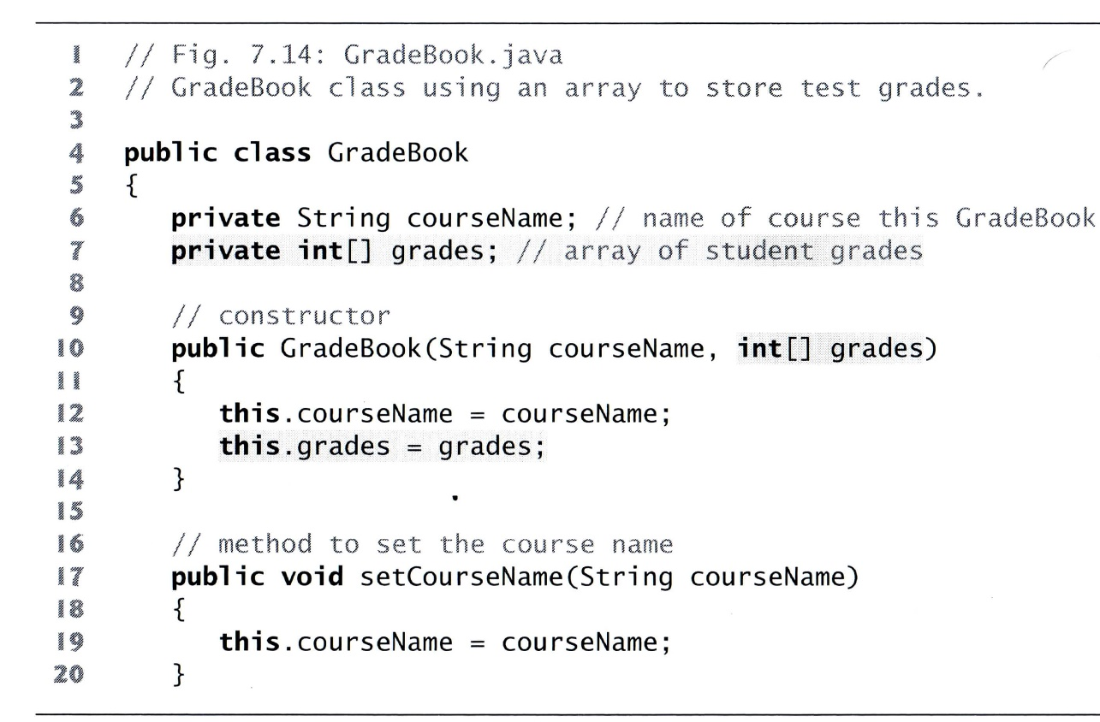
Example 2
Design a class GradeBook to store students’ grades with an array. Use stars (*) to show the statistical analysis of grade distribution. Also show the highest, lowest & average score
Use _________ keyword to refer the instance variable

Slide 19
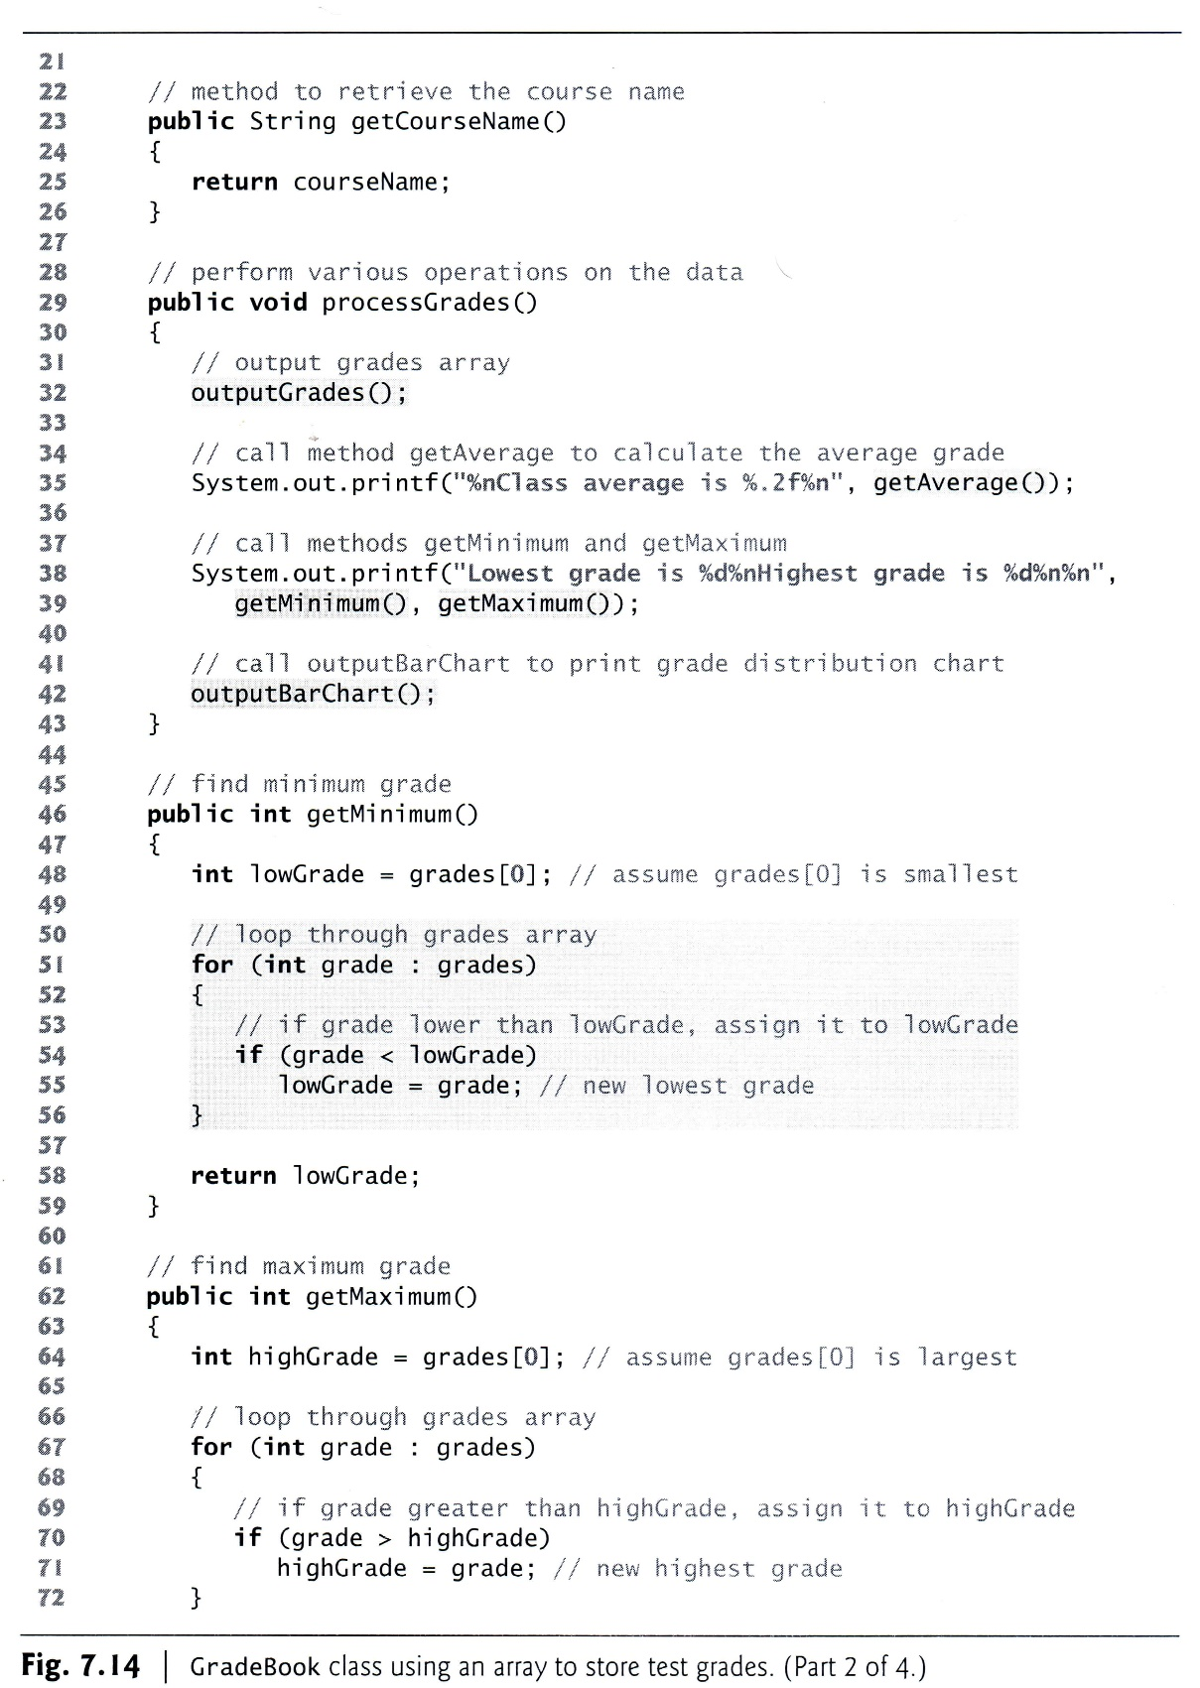

Slide 20
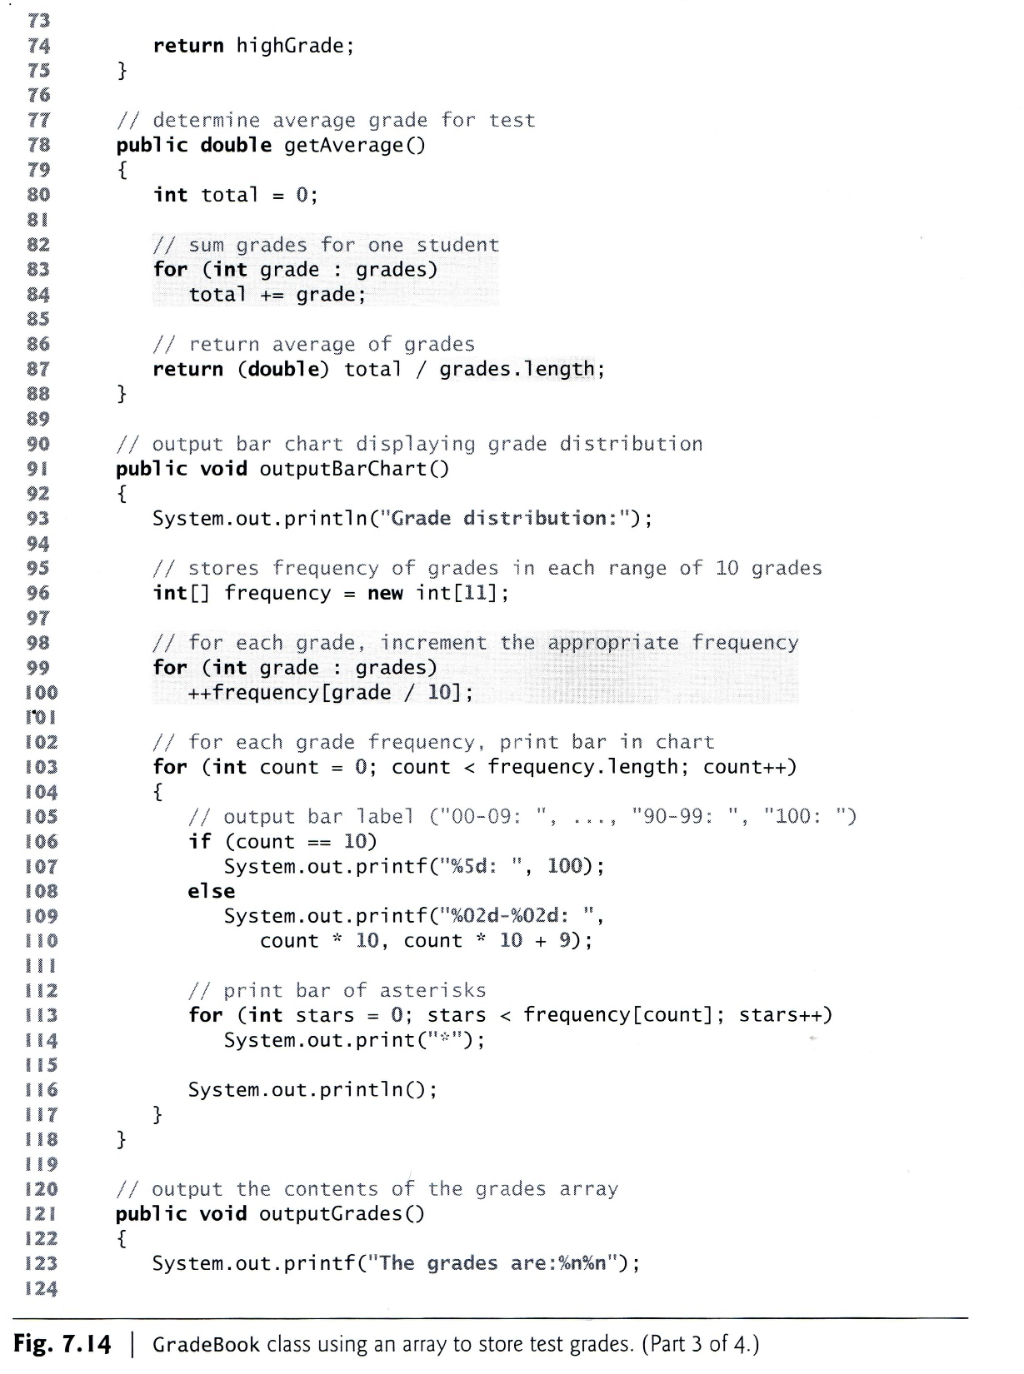

Slide 22
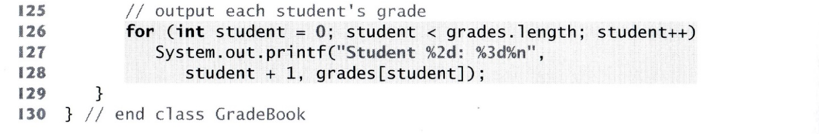
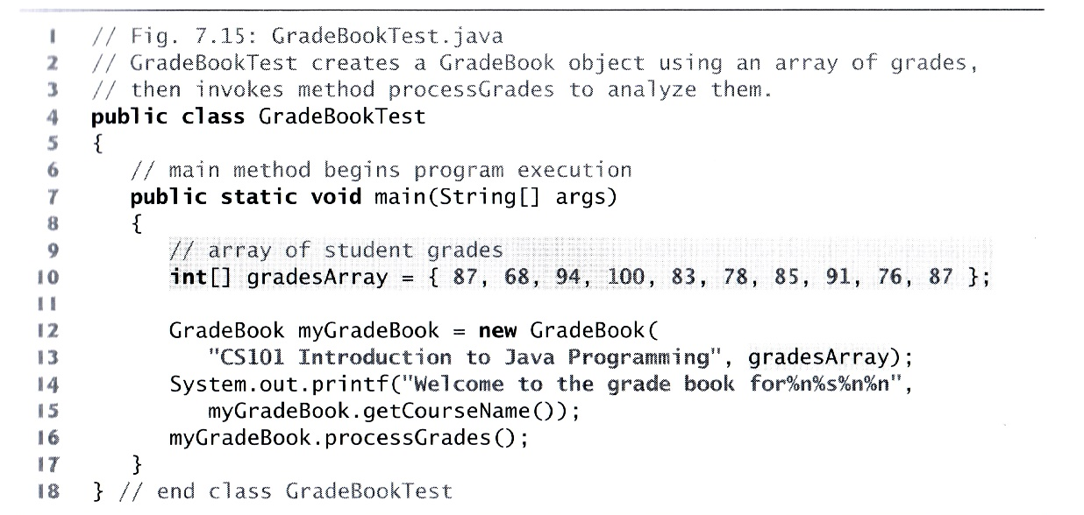

Slide 23
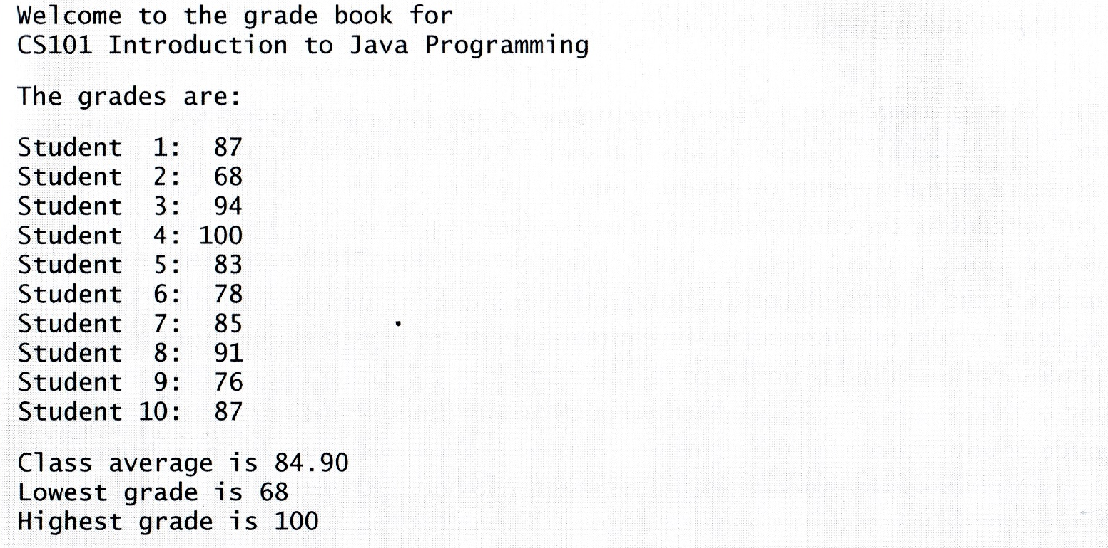
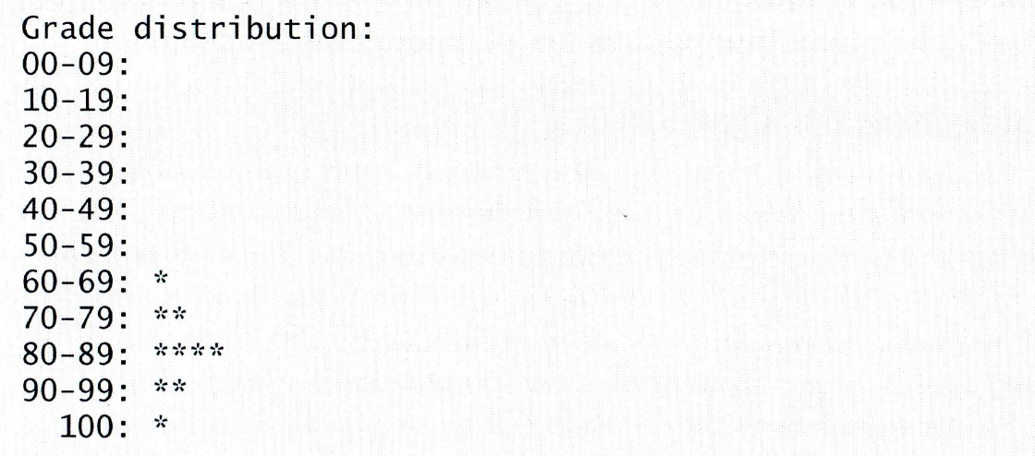
processGrades()的結果
outputGrades()的結果
getAverage()的結果
getMinumum()的結果
getMaximum()的結果
outputBarChart()的結果

Slide 24
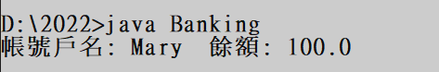
L6-5 Introduce method toString
Java has the toString method for returning a particular string (列印物件) when this method of an object is called.
The method can be redefined if it is needed
Example:
public class Account{
private String name;
private String acctNo;
private double balance;
//the constructors, get-&set- methods 因篇幅在此略
public String toString(){
return “帳號戶名: ” + getName() + “ 餘額: ”+ getBalance();
}
public class Banking{
public static void main(String [] args){
Account a1 = new Account(“Mary”, “001”);
a1.deposit(100.0);
System.out.println(a1);
}
}

Slide 25
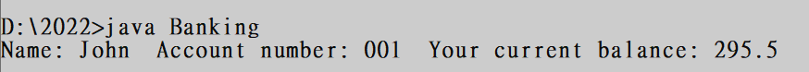
EXE 6_2
(Banking system cont’d). Suppose that opening an account requires customer name, account number, and additionally the amount of money to deposit during the opening.
Define Account’s constructor.
Define the two functional methods: deposit & withdraw. Also define the required service methods.
Implement the toString method for returning the following account summary info: name, account number, & balance
Assume John (customer name) (1)brings $100.0 to open his account, later (2)deposits $995.5 and then (3)withdraws $800. Implement these transactions and use the toString method to print the summary information in the Banking class.
➔ 目標：15 minutes

Slide 26
Case study (1)【某年度Java期中考題】
Suppose you run a store and sell two products: Phone and Camera. You are developing a Java system to keep track of the sales of the products. In the system you have a class called Selling. In Selling you create an object of each product type and use the object to store and update the quantities of the product sold. The Selling class also shows a sales report by calling the toString() of the two product classes.
Implement Phone, Camera and Selling.

Slide 27
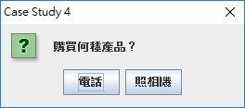
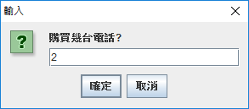
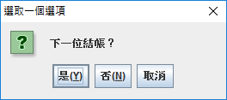

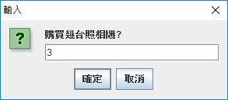
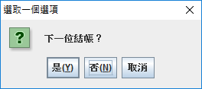
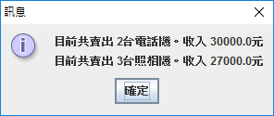

Slide 28
Class Camera
public class Camera{
private int quantity;
private double price;
public Camera(double p, int q){
setPrice(p);
setQuantity(q); }
public void setQuantity(int q){ quantity = q; }
public int getQuantity(){ return quantity; }
public void setPrice(double p){ price = p; }
public double getPrice(){ return price; }
public void sales(int q){ quantity += q; }
public String toString(){
return "目前共賣出 " + getQuantity() + "台照相機。收入 " +
getQuantity()*getPrice() + "元";
}
}

Slide 29
Class Phone
public class Phone{
private int quantity;
private double price;
public Phone(double p, int q){
setPrice(p);
setQuantity(q); }
public void setQuantity(int q){ quantity = q; }
public int getQuantity(){ return quantity; }
public void setPrice(double p){ price = p; }
public double getPrice(){ return price; }
public void sales(int q){ quantity += q; }
public String toString(){
return "目前共賣出 " + getQuantity() + "台電話機。收入 " +
getQuantity()*getPrice() + "元";
}}

Slide 30
Class Selling
import javax.swing.JOptionPane;
public class Selling{
public static void main(String [] args){
Phone p = new Phone(15000.0, 0);
Camera c = new Camera(9000.0, 0);
String products [] = {"電話", "照相機"};
int q = 0, confirm=0;
do{
int product = JOptionPane.showOptionDialog(null, "購買何種產品？", "Case
Study 4", 0, 3, null, products, null);
if(product == 0){
q= Integer.parseInt(JOptionPane.showInputDialog("購買幾台電話?"));
p.sales(q); }
else if(product==1){
q= Integer.parseInt(JOptionPane.showInputDialog("購買幾台照相機?"));
c.sales(q); }
confirm = JOptionPane.showConfirmDialog(null, "下一位結帳？");
}while(confirm == 0);
JOptionPane.showMessageDialog(null, p + "\n" + c);
}
}

Slide 31
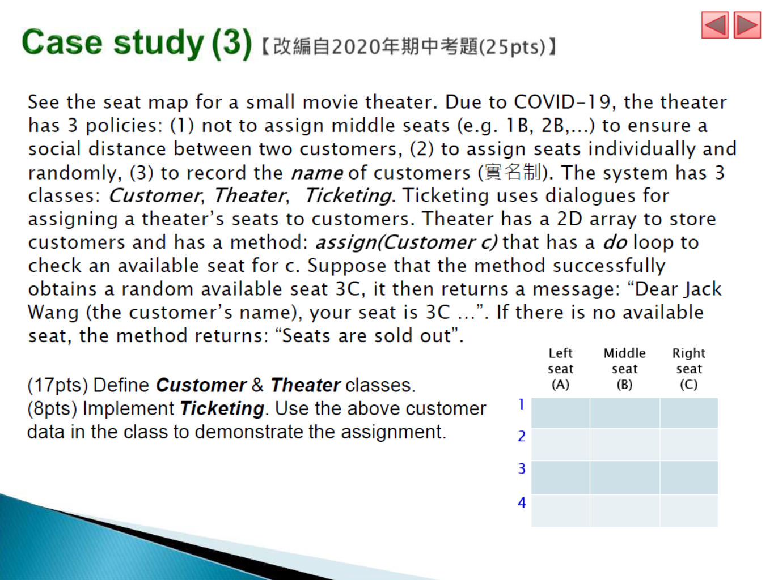
2

Slide 32
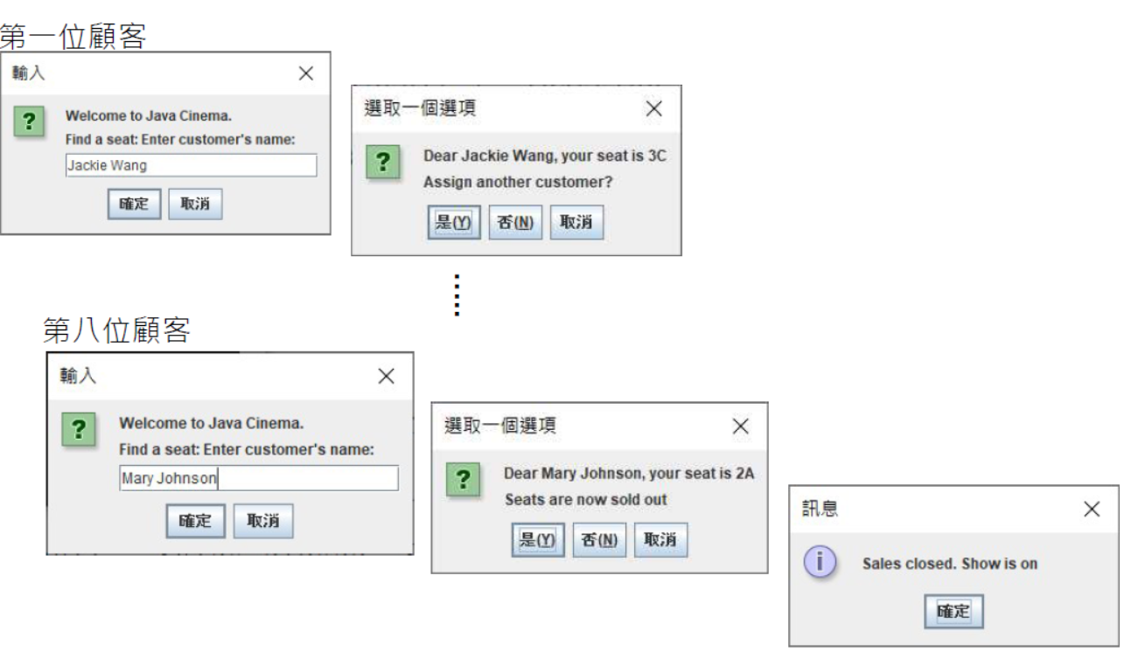

Slide 33
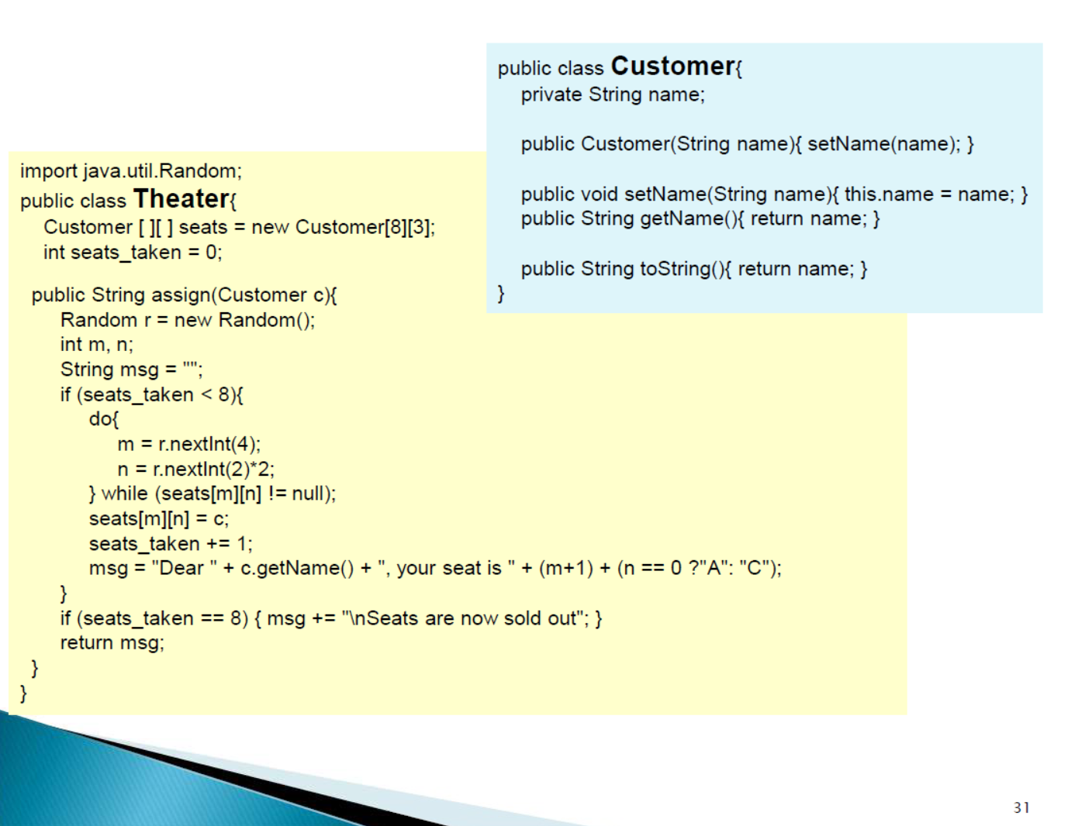

Slide 34
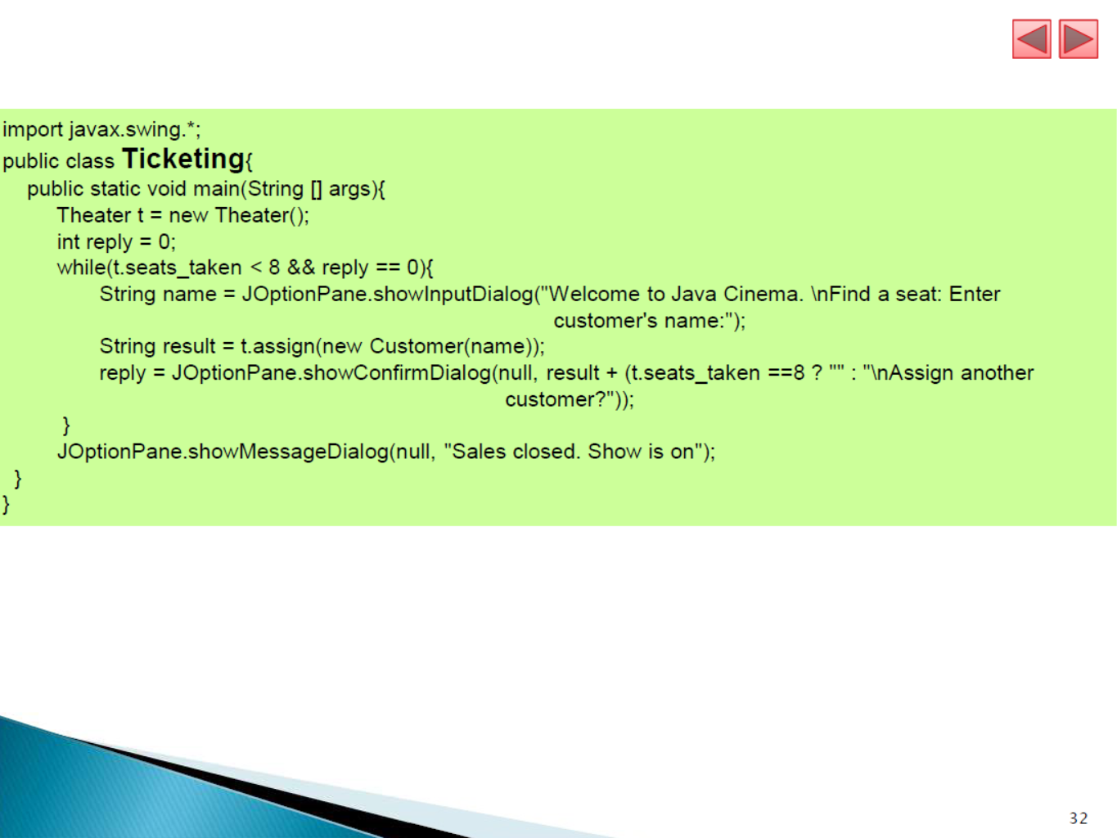

Slide 35

What you have learned..
Class and object concept
Object instantiation
A class has 3 members:
method(s) to perform an object’s function(s) or accessing the object’s private data members
instance variables (also called data members) to store data in an object
constructors for object initialization
Accessibility scope of class members
Entity classes and user classes
The rules of constructors of an entity class
The use of the toString method

Slide 36
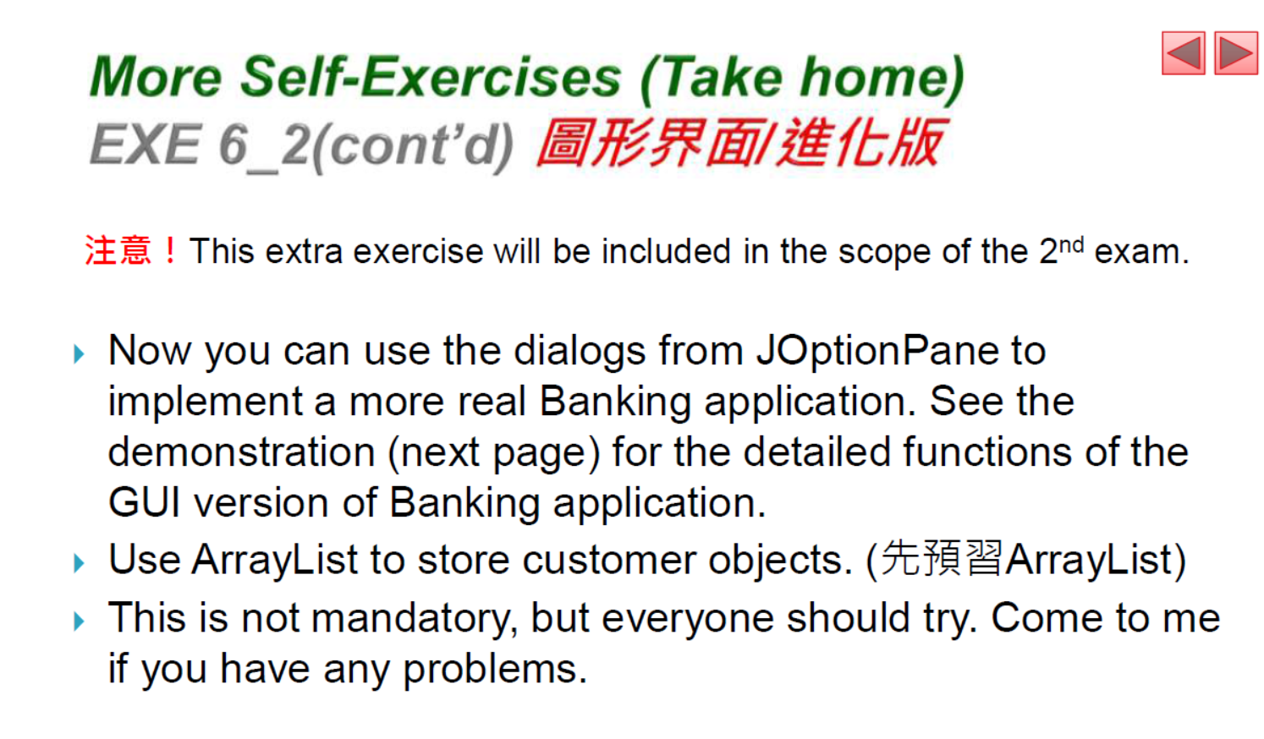

Slide 37
